Slide 1
Keras

Slide 2
Housekeeping
Apparently a few things in the week 3 lecture video were missing, but in the slides
I’ll fix this
Telling me these things is important though, please do
Emailing me 139 minutes before week 5’s class when there will be a previously announced quiz on the topic of week 3’s lecture is not the correct solution
They won’t be on the quiz
Apparently there are anomalies with getting YouTube videos on ELMS for some of you, or when you do there’s a meaningful delay
Subscribing to my YouTube channel or checking it directly is the solution
The last 2 weeks have gone up the Sunday after class
For those of you who can, bringing a Linux or macOS laptop to class for the next several lectures will make your life easier
Pretty much all of today will be a lab
Tell me if the brief interlude on Linux is going to slow
First homework today
Office hours by appointment with me or Thursday afternoon

Slide 3
Yesterday was weird

Slide 4
My wifi card
I got myself a new laptop
The wifi card wasn’t supported in Linux
Then a driver was added to the kernel
Then it’s still mostly broke in Ubuntu network manager and there isn’t a non-awful fix for it
This isn’t fixed by going to the prerelease of the next LTS
Determining the above facts has cumulatively taken 19 hours
This happens a lot in consumer grade Linux only, and with Nvidia drivers
Printer, wifi, other highly consumer focused drivers (capture cards etc.)
So I installed a new Linux distro I’ve been looking to try, Solus

Slide 5
The sins of Debian or why Linux on desktop sucks
No grandfather Linux distro other than Debian has the program, driver, etc support and general features to meaningfully compete with Debian for desktop based Linux distros
This is not remotely true for servers
They don’t require nearly as many new things, or as many things in general
Spending a long time on things is less important because you have to do it so rarely, and massive customization will always be required
Creating UIs that both function and aren’t awful is notably not required
Debian has a very conservative and slow ideology about adding packages and explicit advanced configuration and are remarkably fanatical about security
This is very good for servers and advanced users
This is very bad for users who need new kernels for new hardware and new versions of many programs
In a notable recent incident, the file manager
Having things “just work” is important
Released in discrete versions every few years
Ubuntu is built off debian beta (testing)
Designed to take the weight of Debian and make it suitable for desktop
By redoing UIs, settings, installation menus, etc
Only has LTS releases every 2 years, mostly because of Debians system
These are the only ones that count
It isn’t super polished and frequently doesn’t “just work” and that sucks

Slide 6
What’s in a Distro
Default configurations/packages
Update system and ideology
Package manager
Stiching between some packages
Some unique packages, not too many
Mostly GNU ecosystem

Slide 7
Solus
Desktop only grandfather distro
Actually is good at doing this
Rolling release
Not the bad kind like arch Linux
All software is packaged by them for release from the sources or repos
Including major closed source things like full chrome, steam, Nvidia drivers (yes they even work well)
Software manager (app store) has all these things and actually works
Anything that can’t be done well isn’t done
This is better than Ubuntu’s way
My wifi card works and I haven’t had to use the command line for a single non-programming task
Only notable imitation relevant to this course (or anything I’m aware of) is it doesn’t yet support CUDA
It’s because they want to reduce the monstrosity I previously described to a click
Developers are mature
Working, with real progress, on important consumer facing features (like GPU switching)
UIs are designed by people who should be allowed to design UIs
Highly recommend for anyone afraid of The Linux Demons who wants to try it locally
It can do everything for this course that can be done on a normal laptop

Slide 8
After fixing my wifi card I got talked into going to the CS career fair
The weren’t supposed to let me in, but did anyway and I don’t know why
I briefly talked to the lead HR person for the data science division of the NSA
She seemed to take the tone of “people who don’t want to work for us only because we aren’t able to pay a meaningful percentage of their industry rate are bad people”
GS15 is the average starting salary of a data scientist in silicon valley
I find that odd
Then I went and talk to someone who works on machine learning for Microsoft Azure
What are these cloud machine learning things?
Why is using them a terrible idea?
“No I totally agree, us and AWS can’t remotely compete to GCP for machine learning, we’re just forced to tell our customers that”
PASCAL architecture GPUs are just now going into closed beta there
“So are the horror stories true? Are your ML people really forced to try doing all their ML on Windows and with your weird ecosystem with CTNK and so on?”
“Basically yes, but everyone uses keras around it so it doesn’t really matter”
You shouldn’t use Keras for a lot of things

Slide 9
Keras
-I haven’t had time to review this by myself so this will be interesting
-For those of you following along with the documentation on Google, raise your hand to correct me when applicable

Slide 10
What’s Keras?
Python Library
High level wrapper around most major ML compute libraries (“backends”)
The important one is TensorFlow
Microsoft added CTNK as a backend so that the developers they’ve sentenced to using it can actually function
Don’t.
Much faster to write in and debug than low level languages
Due to inefficiencies in instructions runs ~3 times slower than raw code (rough estimate that’s highly situationally dependent)
Factor of 3 for CPU run time often doesn’t matter
For mass scale stuff or things that are heavily pushing resources it does
Especially if it doesn’t parallelize
Sort of analogous to trade offs in using C vs higher level language
Really popular, de facto standard of high level wrappers, no “right” one at this level
TensorFlow.keras
I’ve never found a way of “teaching” an API that makes sense
But I apparently have to
So we’ll be going through the documentation and a sample piece of code that isn’t perfect
This shouldn’t be long, the lab should be long
https://archive.ics.uci.edu/ml/datasets/breast+cancer+wisconsin+%28original%29

Slide 11
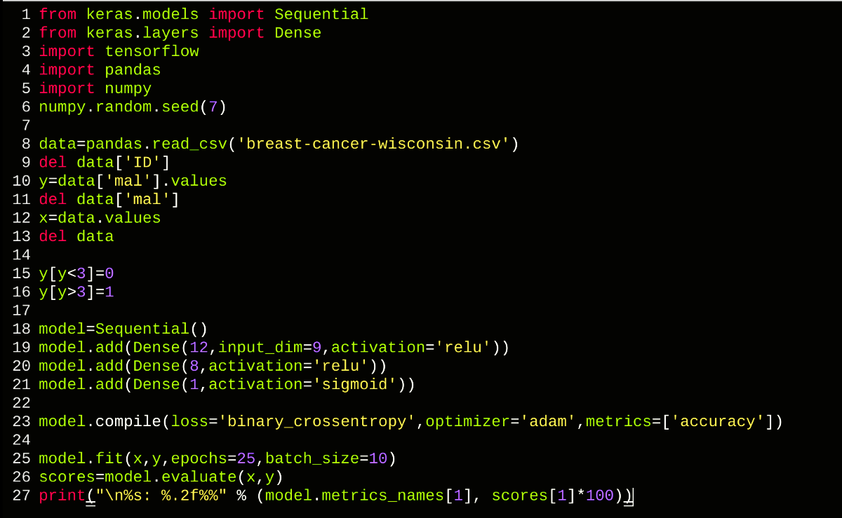

Slide 25
Lab
Using keras on this data set predict the age of abalone
Note UCI ML Repo
Everything to do this (outside of theory) hasn’t been explicitly covered
This is intentional
Asking questions when stuck and Googling things is highly recommended
Hint: what loss function should you use?
Learning to Google things you don’t know (for this and otherwise) is a really important skill
CPU acceleration is enough for this
If you have a local Linux desktop, you’ll probably want to use it instead
Everything today should work on macOS too

Slide 26
Homework
Do the predictions in Keras for these data sets
http://archive.ics.uci.edu/ml/datasets/Breast+Cancer+Wisconsin+%28Diagnostic%29
http://archive.ics.uci.edu/ml/datasets/Iris
https://www.kaggle.com/danielhkl/mnist-original-dataset/data
Specifics of how to submit code will be included on ELMS
Doing what is says is very important
Due date is TBD, basically when people are comfortable
Waiting infinitely is not a solution though, there will be weekly homework for most of the rest of the semester

